Slide 1

APEX INSTITUTE OF TECHNOLOGY
DEPARTMENT OF COMPUTER SCIENCE & ENGINEERING
Computer Organization & Architecture (21CSH-281)
Faculty: Siddharth Kumar (E12853)
Lecture - 8
Instruction set architecture of a CPU: Addressing Modes
DISCOVER . LEARN . EMPOWER

Slide 2
Computer Organization & Architecture: Course Objectives
COURSE OBJECTIVES
The course aims to:
The purpose of the course is to introduce principles of computer organization and the basic architectural concepts.
It begins with basic organization, design, and programming of a simple digital computer and introduces simple register transfer language to specify various computer operations.
Topics include computer arithmetic, instruction set design, microprogrammed control unit, pipelining and vector processing, memory organization and I/O systems, and multiprocessors.
To familiarize Students with the detailed Architectures of a Central Processing Unit.
Learn the different types of serial communication techniques.

Slide 3
COURSE OUTCOMES
On completion of this course, the students shall be able to:-
CO1 | Identify and interpret the basics of instruction sets and their impact on the design, organization, and functionality of various functional units of a computer comparable to the CPU, memory organization, I/O organization, and parallel processors.
CO2 | Analysis of the design of arithmetic & logic unit and understanding of the fixed point and floating-point arithmetic operations.
CO3 | Relate cost performance and design trade-offs in designing and constructing a computer processor which includes memory.
CO4 | Understanding the different ways of communicating with I/O devices and standard I/O interfaces.
CO5 | Implementation of control unit techniques and the concept of Pipelining.

Slide 4
Addressing Modes & Instruction Cycle
The operation field of an instruction specifies the operation to be performed. This operation will be executed on some data which is stored in computer registers or the main memory. The way any operand is selected during the program execution is dependent on the addressing mode of the instruction. The purpose of using addressing modes is as follows:
To give the programming versatility to the user.
To reduce the number of bits in addressing field of instruction.
The term addressing modes refers to the way in which the operand of an instruction is specified. The addressing mode specifies a rule for interpreting or modifying the address field of the instruction before the operand is actually executed.
The operands of the instructions can be located either in the main memory or in the CPU registers. If the operand is placed in the main memory, then the instruction provides the location address in the operand field. Many methods are followed to specify the operand address. The different methods/modes for specifying the operand address in the instructions are known as addressing modes.

Slide 5
Types of Addressing Modes: There are various types of Addressing Modes which are as follows −
Implied Mode − In this mode, the operands are specified implicitly in the definition of the instruction. For example, the instruction "complement accumulator" is an implied-mode instruction because the operand in the accumulator register is implied in the definition of the instruction. All register reference instructions that use an accumulator are implied-mode instructions. Instruction format with mode field
Immediate Mode − In this mode, the operand is specified in the instruction itself. In other words, an immediate-mode instruction has an operand field instead of an address field. The operand field includes the actual operand to be used in conjunction with the operation determined in the instruction. Immediate-mode instructions are beneficial for initializing registers to a constant value.
Register Mode − In this mode, the operands are in registers that reside within the CPU. The specific register is selected from a register field in the instruction. A k-bit field can determine any one of the 2^{k} registers.
Opcode | Mode | Address

Slide 6
Register Indirect Mode − In this mode, the instruction defines a register in the CPU whose contents provide the address of the operand in memory. In other words, the selected register includes the address of the operand rather than the operand itself. A reference to the register is then equivalent to specifying a memory address. The advantage of a register indirect mode instruction is that the address field of the instruction uses fewer bits to select a register than would have been required to specify a memory address directly.
Autoincrement or Autodecrement Mode & Minuend; This is similar to the register indirect mode except that the register is incremented or decremented after (or before) its value is used to access memory. When the address stored in the register defines a table of data in memory, it is necessary to increment or decrement the register after every access to the table. This can be obtained by using the increment or decrement instruction.
Direct Address Mode − In this mode, the effective address is equal to the address part of the instruction. The operand resides in memory and its address is given directly by the address field of the instruction. In a branch-type instruction, the address field specifies the actual branch address.

Slide 7
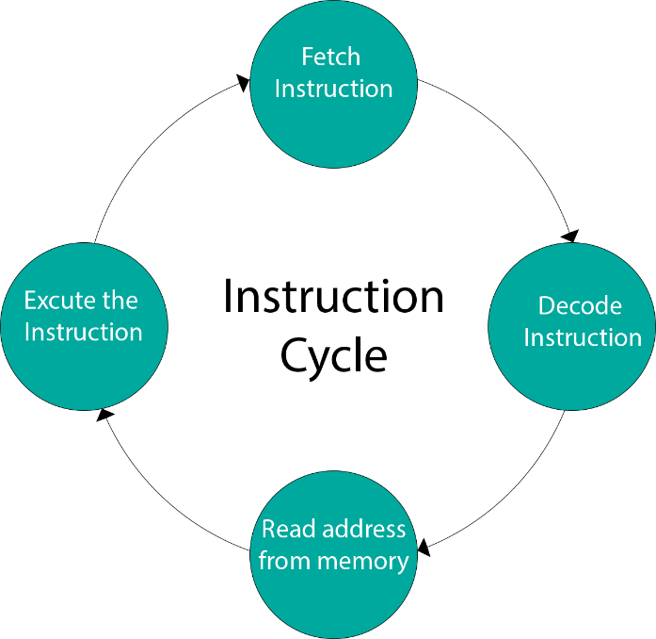
Indirect Address Mode − In this mode, the address field of the instruction gives the address where the effective address is stored in memory. Control fetches the instruction from memory and uses its address part to access memory again to read the effective address.
Indexed Addressing Mode − In this mode, the content of an index register is added to the address part of the instruction to obtain the effective address. The index register is a special CPU register that contains an index value. The address field of the instruction defines the beginning address of a data array in memory.
Instruction Cycle −

Slide 8
Summary
Discussed about Addressing Modes & Instruction Cycle.
Discussed about Instruction Cycle.
Assessment Questions
Q1. What are Addressing Modes?
Q2. What is Instruction Cycle?

Slide 9
THANK YOU

